Slide 1


NEXT GEN EMPLOYABILITY PROGRAM
CREATING A FUTURE-READY WORKFORCE
Student Name :
UDHAV CHANDRA RAVI
Student ID :
College Name :
Indira Gandhi National Open University
STU65b611ceba14f1706430926

Slide 2
CAPSTONE PROJECT SHOWCASE
Project Title
Bus Reservation System
Abstract | Problem Statement | Project Overview | Proposed Solution | Technology Used | Modelling & Results | Conclusion | Q&A

Slide 3
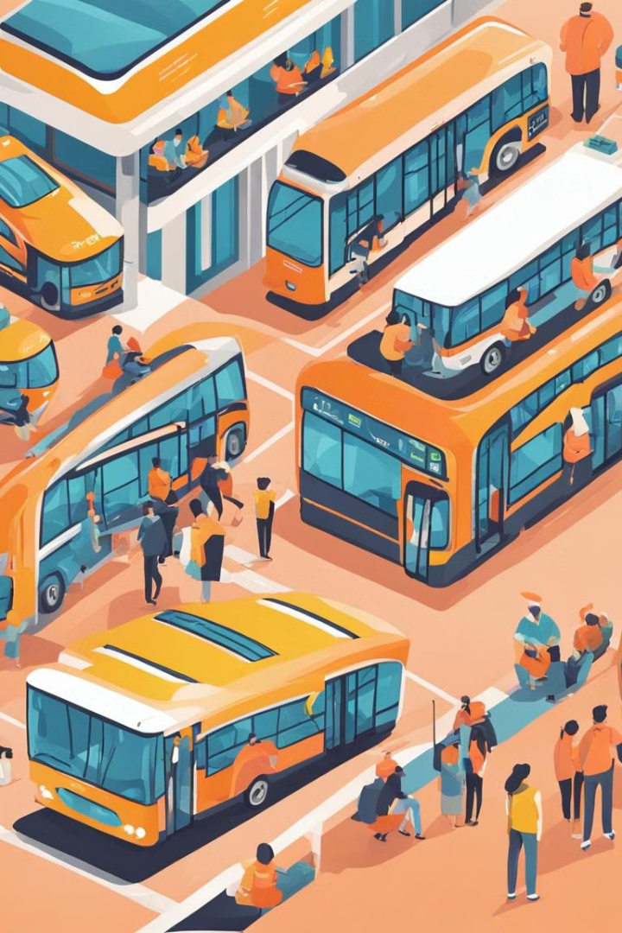
Abstract
Bus Reservation System
The Bus Reservation System is a modern and efficient way to manage and book bus tickets. It offers a convenient and user-friendly platform for travelers to plan and secure their trips.

Slide 4


Problem Statement
Ticket Management
Information Accessibility
Operational Inefficiencies
1
2
3
There are challenges in managing bus routes, ticket inventories, and reservations.
The current manual ticketing system leads to long queues and delays.
Passengers struggle to access real-time bus schedules and availability.

Slide 5


Project Overview
Scope Definition
Resource Allocation
Allocation of development resources for building the system's architecture and features.
The project will involve defining the requirements and goals of the Bus Reservation System.

Slide 6

Proposed Solution
Automated Management
Online Booking System
Real-Time Updates
Introducing an efficient online platform for booking and managing bus tickets.
Providing passengers with real-time information on bus schedules and seat availability.
Implementing automated ticketing and bus route management for operational efficiency.

Slide 7





Technology used
HTML is a markup language used for creating and structuring web pages.
CSS (Cascading Style Sheets) is a language used for describing the presentation of a document written in HTML or XML.
JavaScript is a versatile scripting language primarily used for web development, enabling interactive and dynamic user experiences.
Python is a high-level programming language known for its simplicity, versatility, and readability, suitable for a wide range of applications from web development to scientific computing.
Django is a high-level Python web framework that encourages rapid development and clean, pragmatic design.

Slide 8
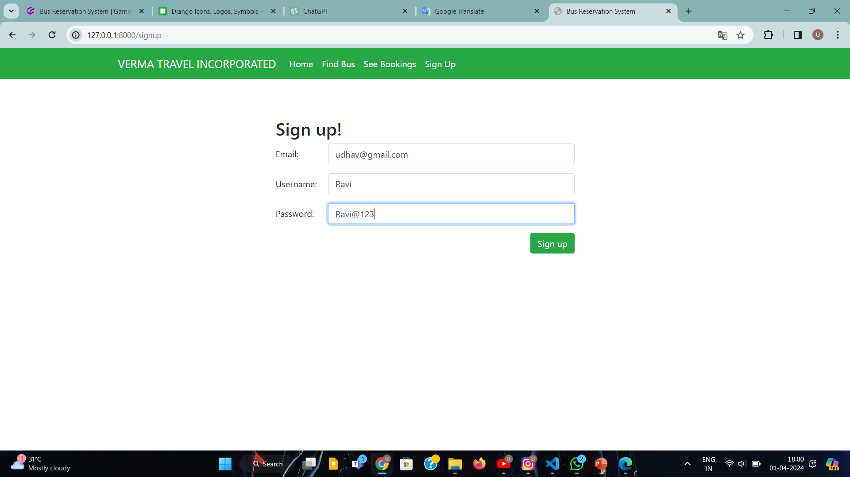
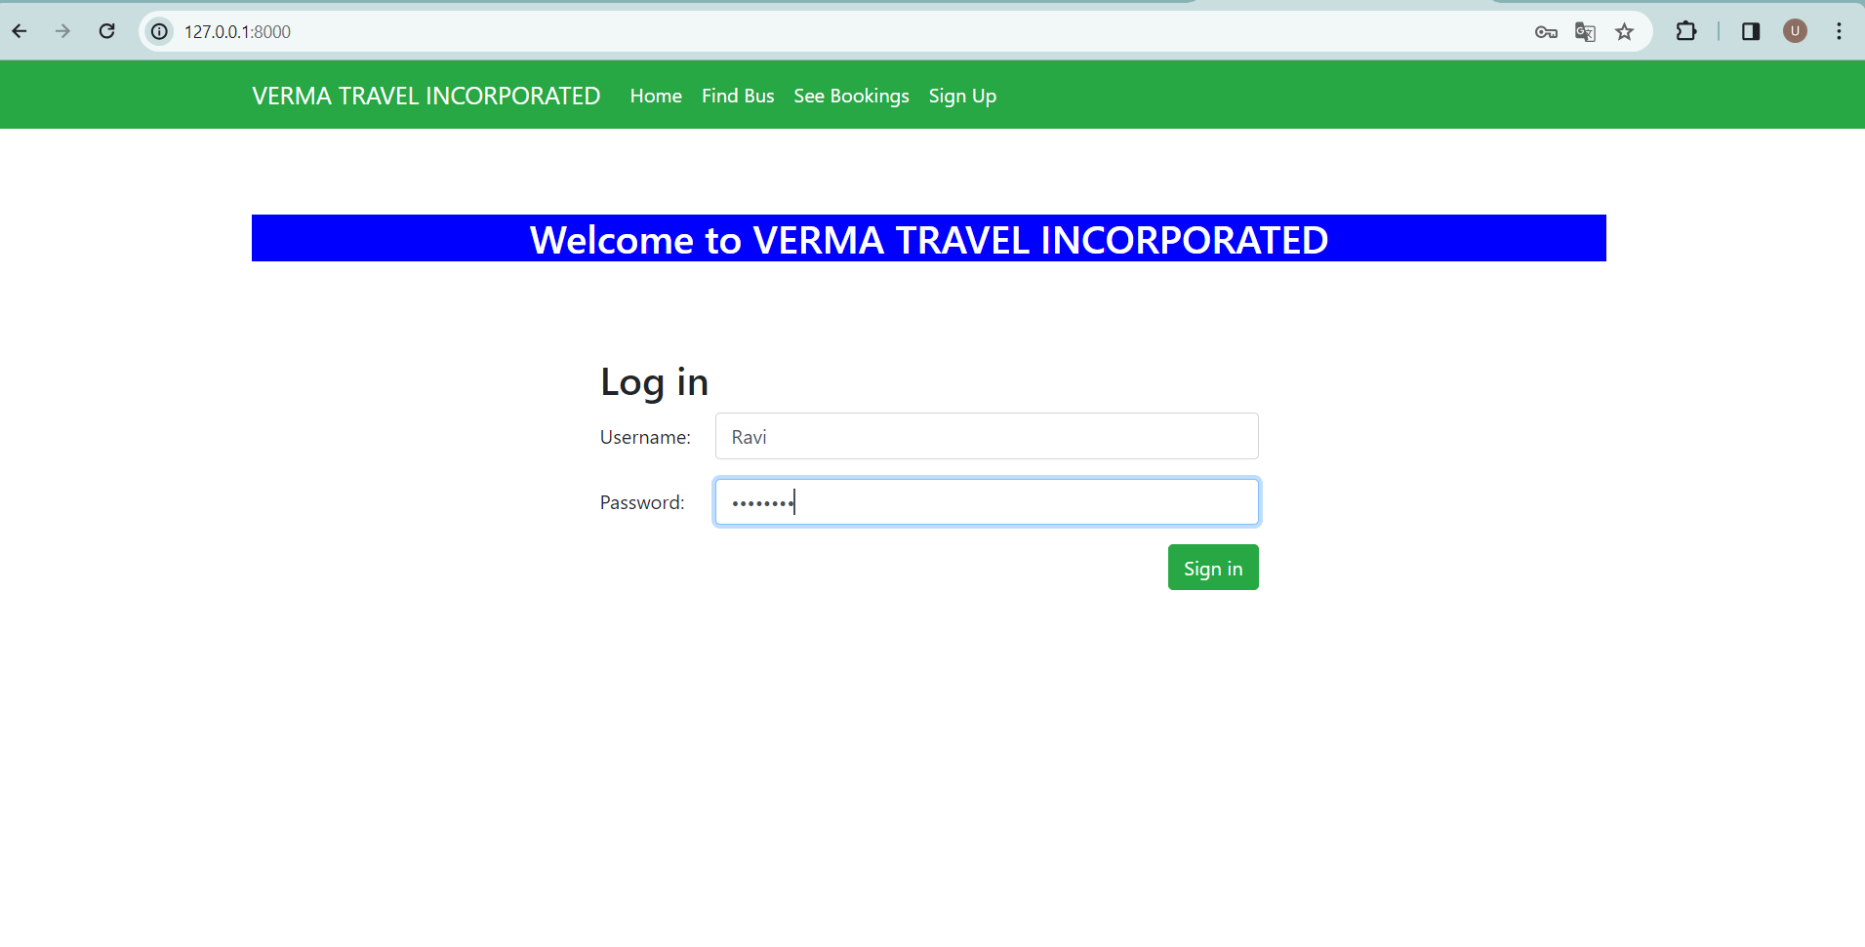
Modelling & Result

Slide 9
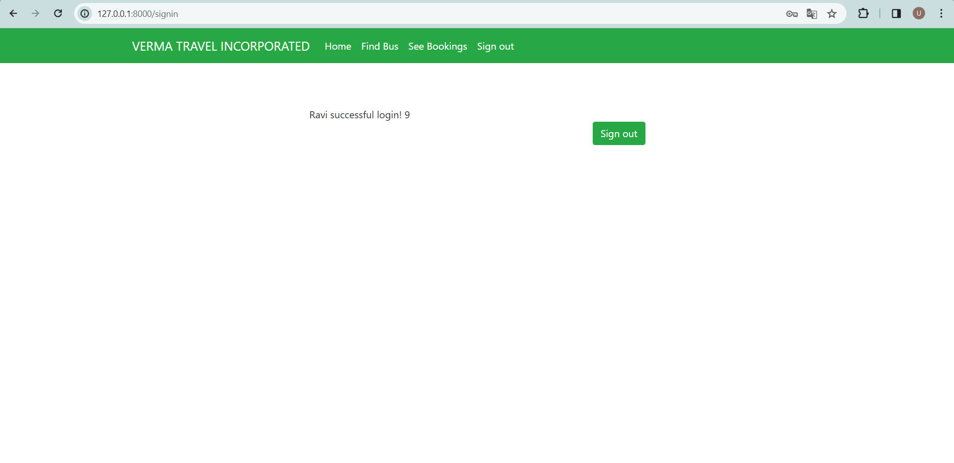
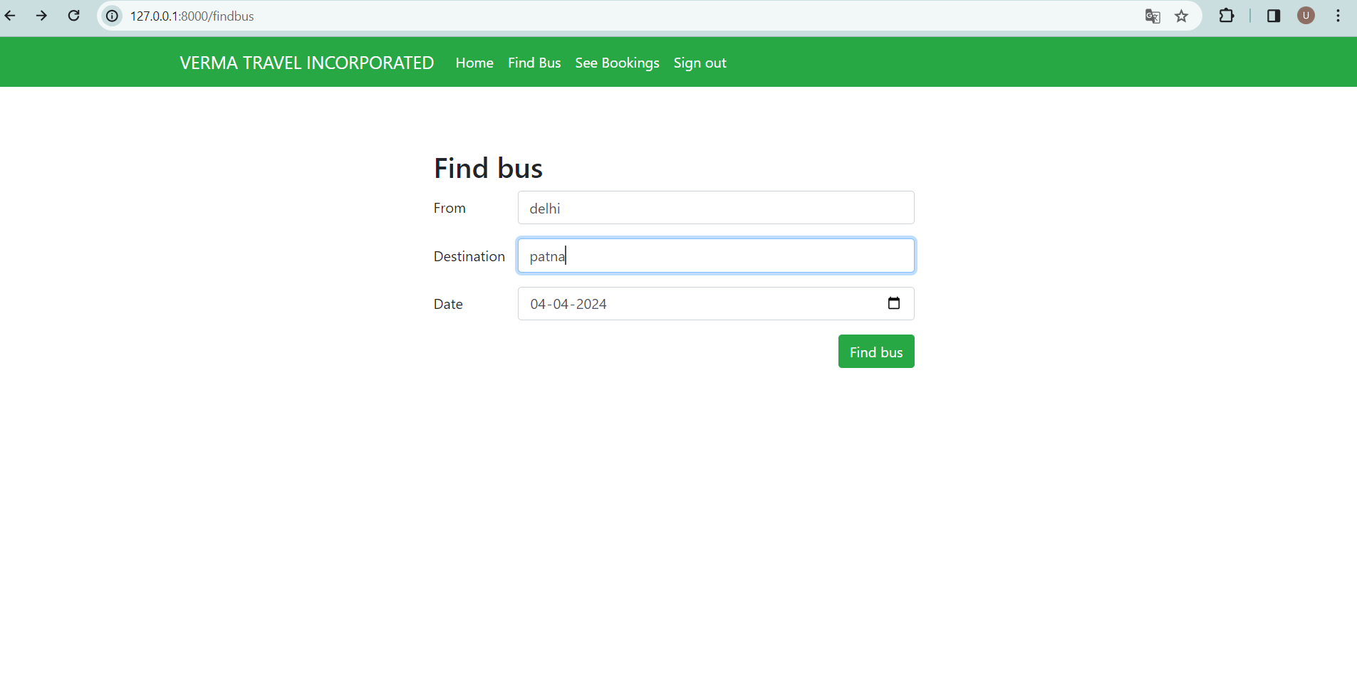
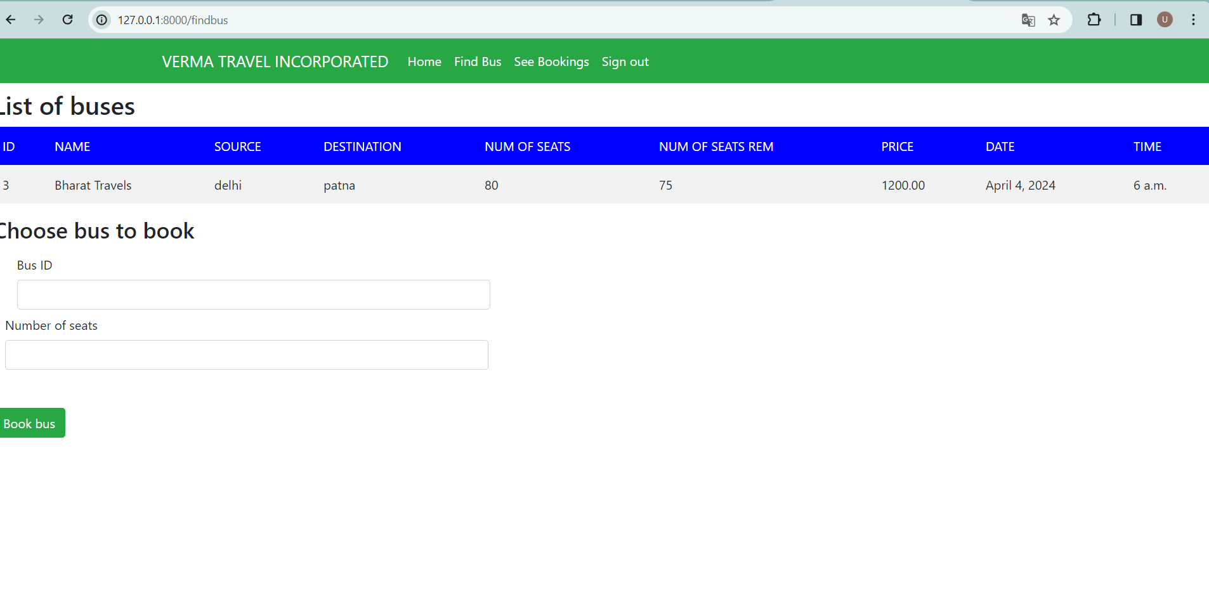
Modelling & Result

Slide 10
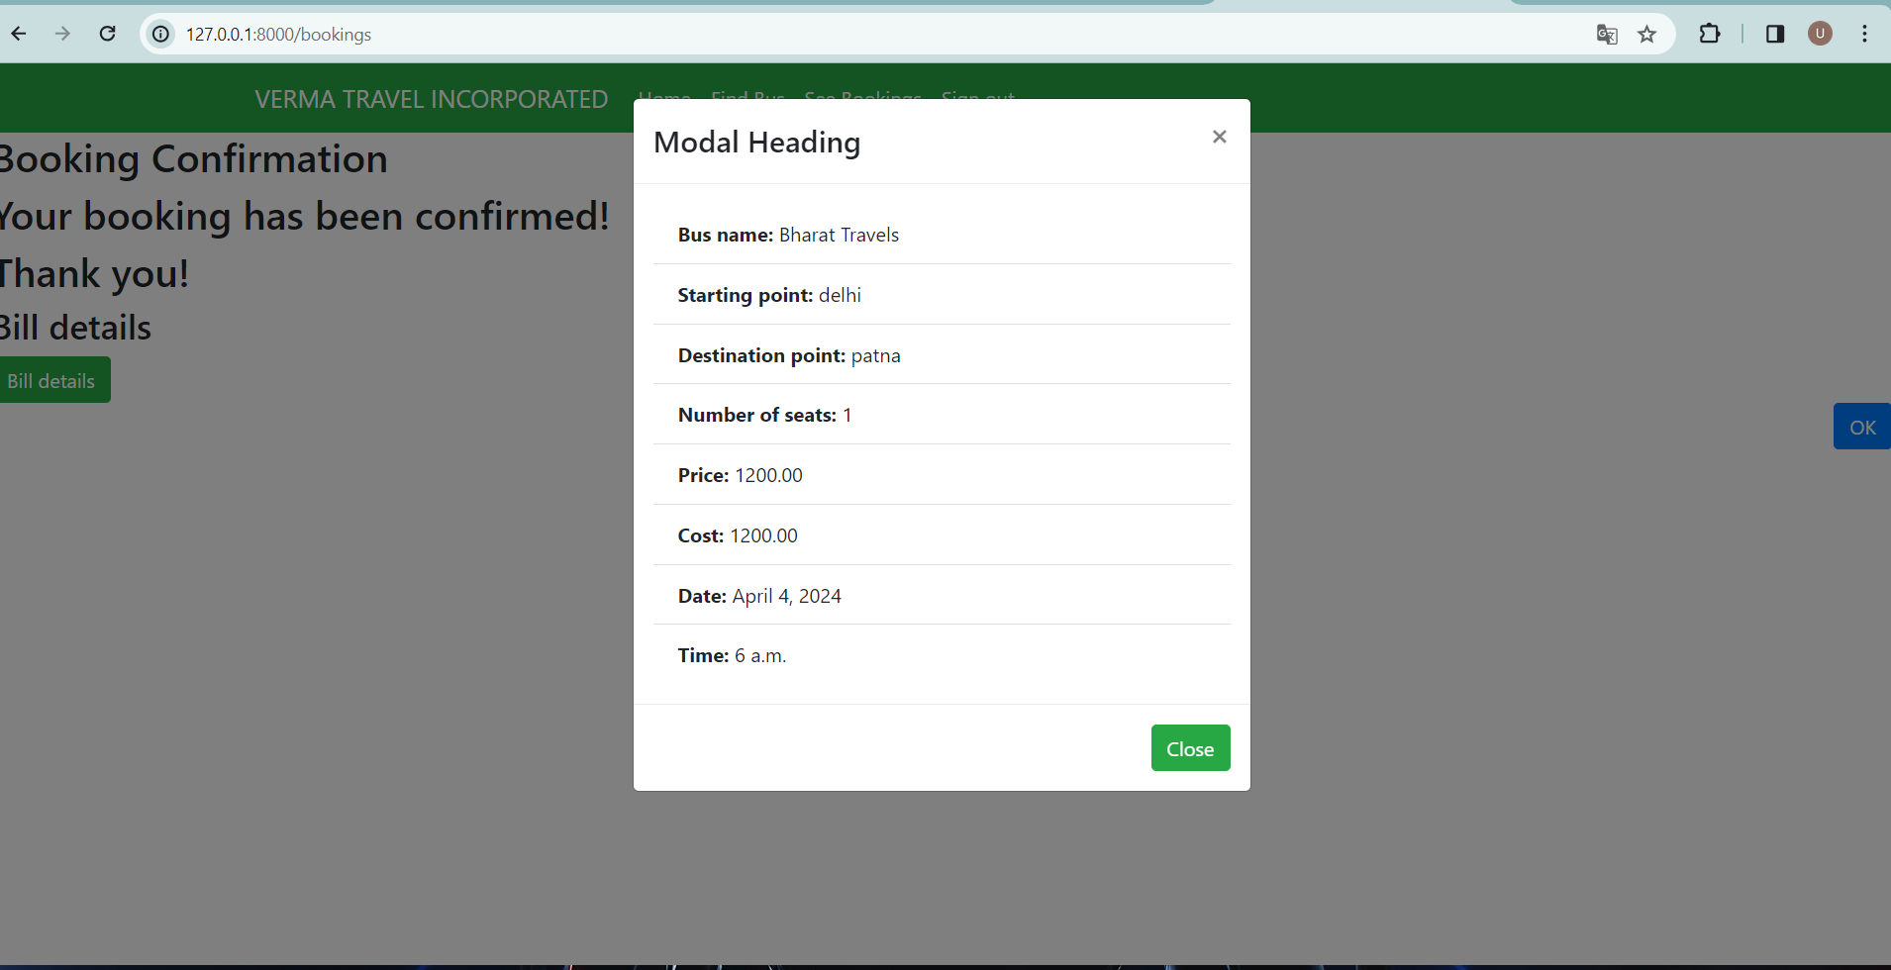
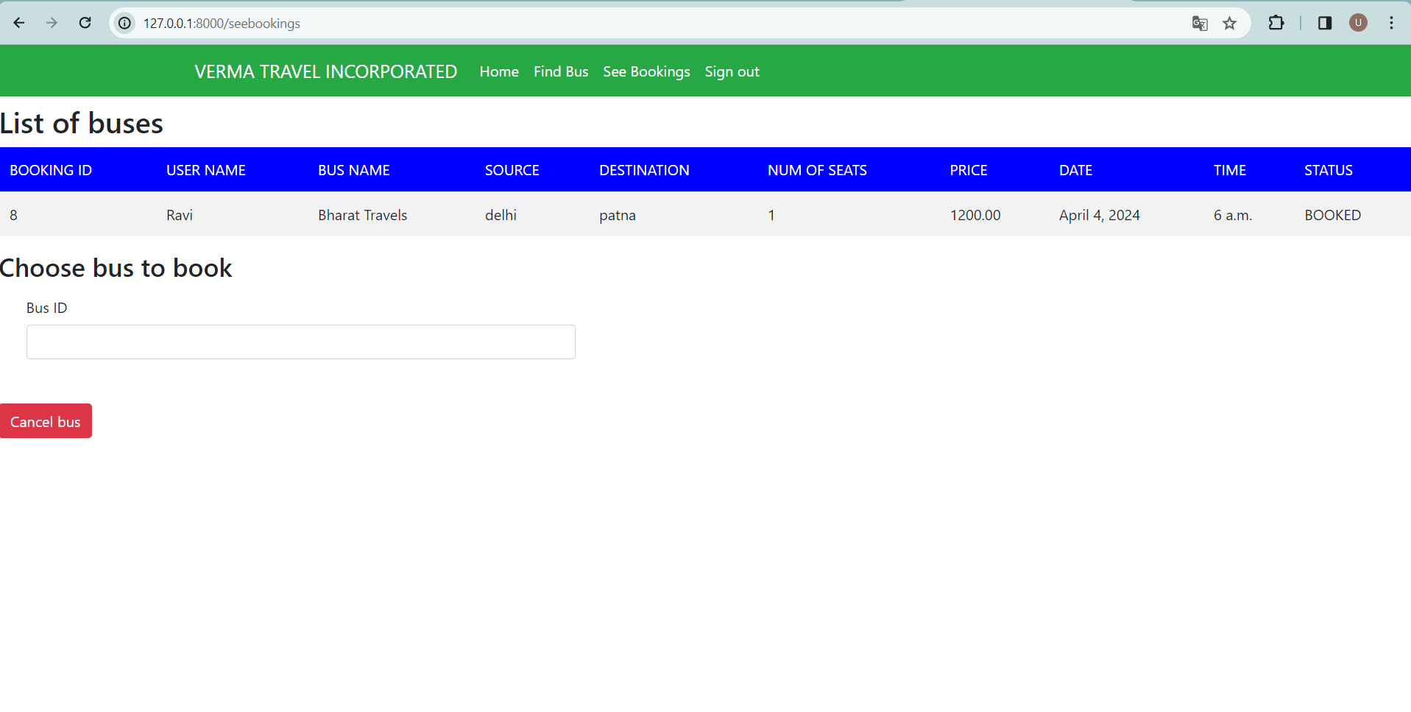
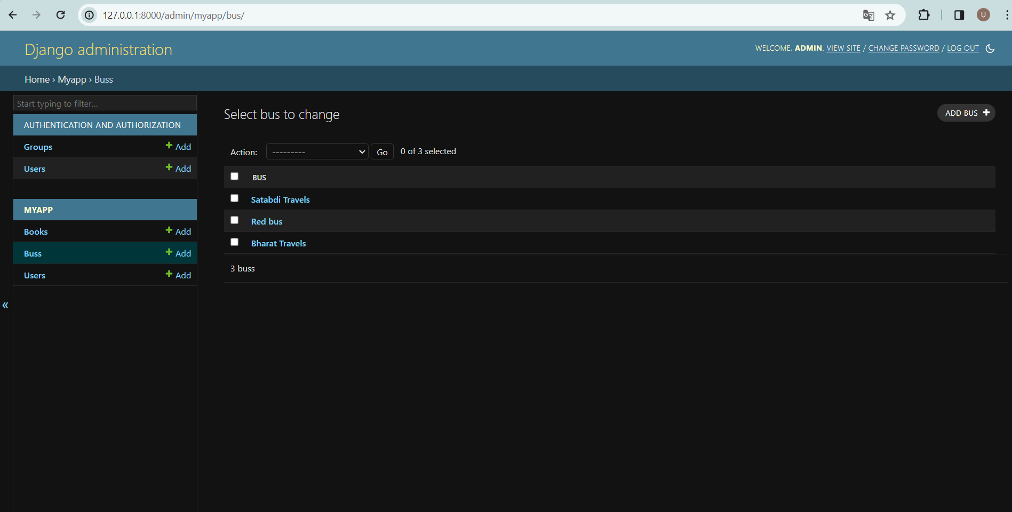
Modelling & Result

Slide 11
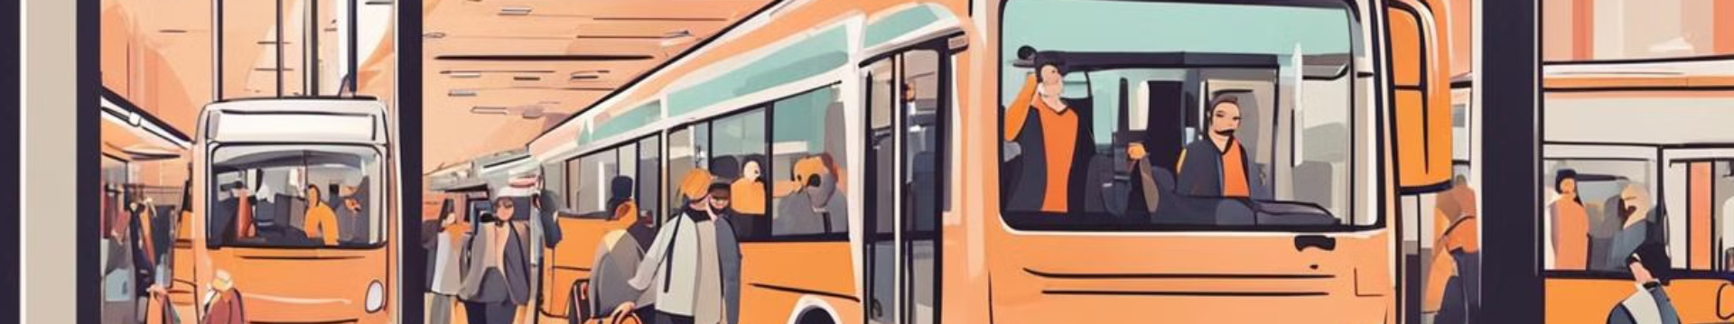



Conclusion
Improved Travel Experience
Streamlined Operations
Future Expansion
Efficient and automated bus management, leading to operational excellence.
The Bus Reservation System has the potential for future scalability and growth.
Enhanced convenience and accessibility for passengers.

Slide 12


Notes:
Thank You !!

